Slide 1
THE IMPORTANCE OF AI IN HEALTHCare
Name : 25K-0610 – Muhammad Siddique
Course : BCS
Section : 1C

Slide 2

What Is AI IN HEALTHCare
AI in healthcare refers to the use of algorithms and machine learning models to improve healthcare processes, from diagnosis to treatment.

Slide 3
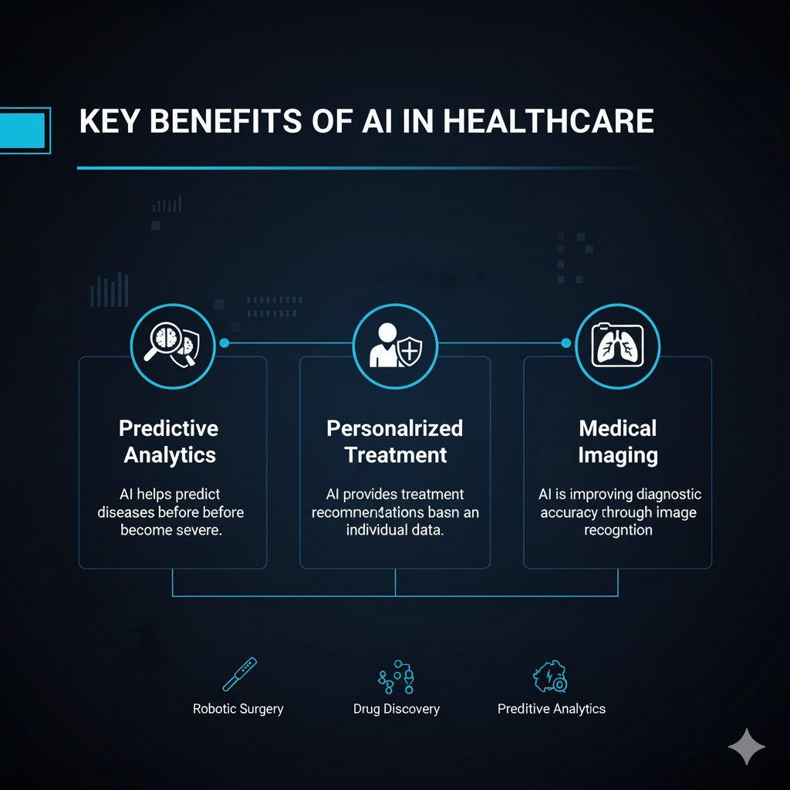
How AI Improves HEALTHCare
Predictive Analytics: AI helps predict diseases before they become severe.
Personalized Treatment: AI provides treatment recommendations based on individual data.
Medical Imaging: AI is improving diagnostic accuracy through image recognition.

Slide 4
Quiz: What Is the primary Benefit Of AI In HealthCare?
Faster Diagnosis.
Personalized Treatment.
Predicting Diseases.

Slide 5
Correct Answer
Explaination:
AI is transforming healthcare by enabling faster, more accurate diagnoses, leading to earlier interventions.
GO TO NEXT QUESTION

Slide 6
Incorrect Answer
Explaination:
AI helps in personalized treatment and disease prediction, but its key benefit is faster diagnosis.
GO BACK TO QUESTION

Slide 7
Quiz: Which Healthcare Field Benefits The Most From AI?
Radiology.
Neurology.
Dermatology.

Slide 8
Correct Answer
Explaination:
AI in radiology is being used to detect cancers and other diseases with more precision and speed.

Slide 9
Incorrect Answer
Explaination:
AI is important in dermatology and neurology, but it’s most commonly applied in radiology.
GO BACK TO QUESTION

Slide 10
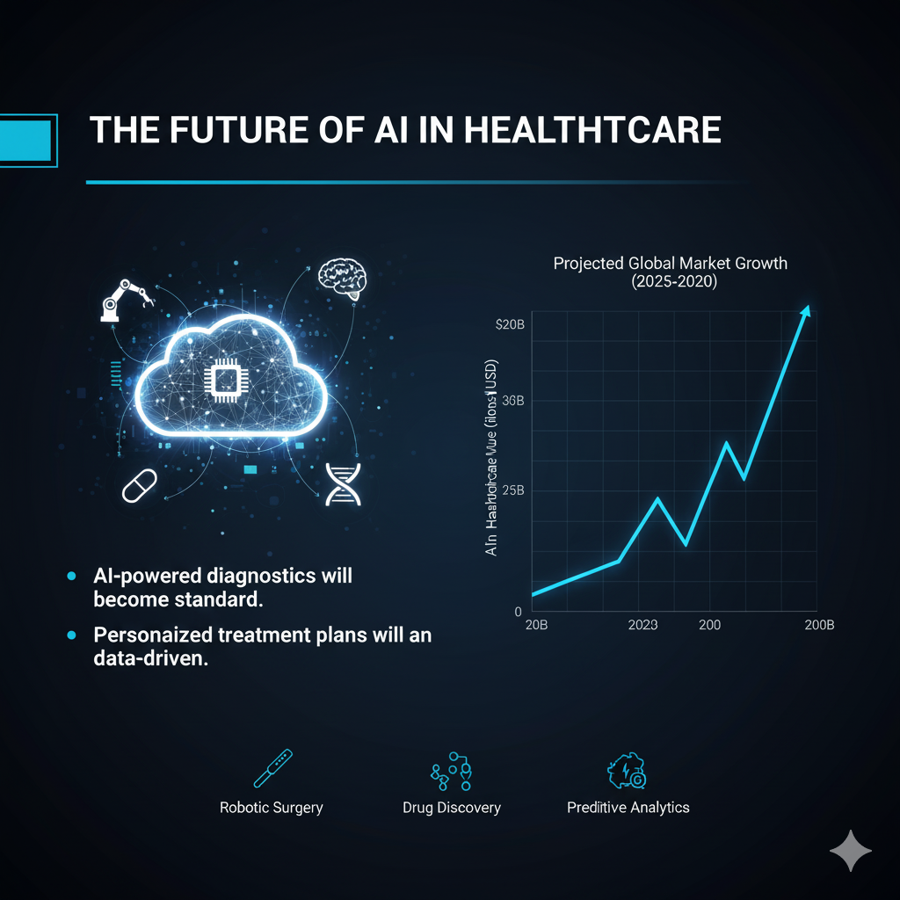
Conclusion
AI in healthcare means using technology to enhance, rather than replace, human connection and empathy in patient care. It involves leveraging AI's ability to automate tasks and analyze data, thereby freeing up healthcare professionals to focus on more direct patient interactions. The goal is to create a more efficient and personalized healthcare system where technology and human expertise work together.

Slide 11

Thank You
THE END.

